Slide 1
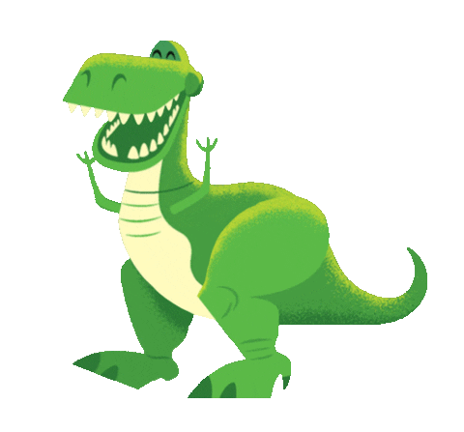
GRADE 5
UNIT FIVE
The dinosaur museum
Lesson 6

Slide 4
START

Slide 5
Click on the right question word to complete the sentence.
NEXT
When
________ did she go to the zoo? She went to the zoo last month.

Slide 6
Click on the right question word to complete the sentence.
NEXT
What
__________ did you eat this afternoon? I ate soup and an egg.

Slide 7
Click on the right question word to complete the sentence.
NEXT
Where
__________ did your best friend go yesterday? She went to the shopping mall.

Slide 8
Click on the right question word to complete the sentence.
NEXT
When
_________ was the football match? It was last Sunday.

Slide 9
Click on the right question word to complete the sentence.
NEXT
Where
________ did you go five days ago? I went to the park.

Slide 10
Click on the right question word to complete the sentence.
NEXT
What
__________ did she see at the beach? She saw many seashells.

Slide 11
LISTEN AND NUMBER
3
4
2

Slide 12
Listen again and circle the children's favorite things.
3
4
2

Slide 13
Ask and answer about the children above.
Linh Hoang Thu Vinh | cave zoo swimming pool island
Example: Where did Linh go? What did she see? What did she like? | She went to a … She saw … She liked …

Slide 14
LISTEN AND SING

Slide 16
Writing: About me
We use exclamation points (!) to show strong feelings, for example, surprise or excitement, or after an instruction. The dinosaur moved! [F] Don’t touch the bones! [I] | 4. Imagine you are in a cave. Write some sentences with exclamation point. 1. Be careful! __ I __ 2. It's so big! _____ 3. _______________ 4. _______________ 5. _______________

Slide 17
WORKBOOK TIME

Slide 18
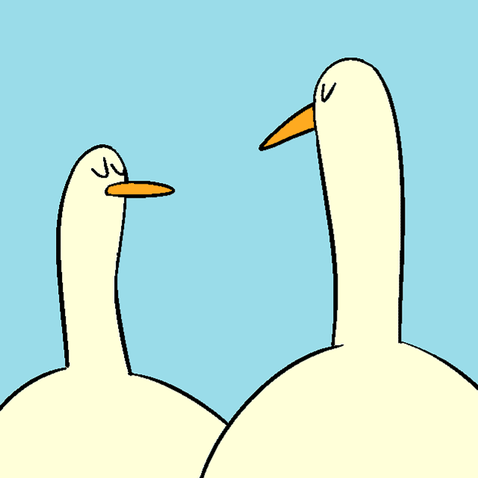
GOODBYE!!!

